Slide 1

CL-2006 Operating Systems Lab Introduction to Linux
Lab 1
Section B1 and B2

Slide 2
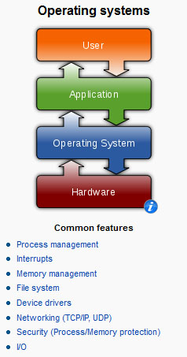
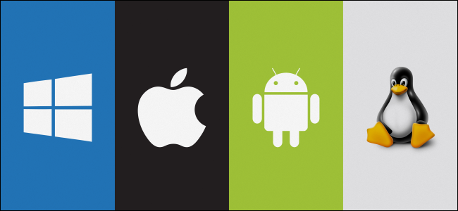
What is Linux?
It’s an Operating System
Notes:
Operating systems graphic source: http://en.wikipedia.org/wiki/Operating_system

Slide 3
Introduction: What is Unix?
An operating system
Developed at AT&T Bell Labs in the 1960’s
Command Line Interpreter
GUIs (Window systems) are now available

Slide 4

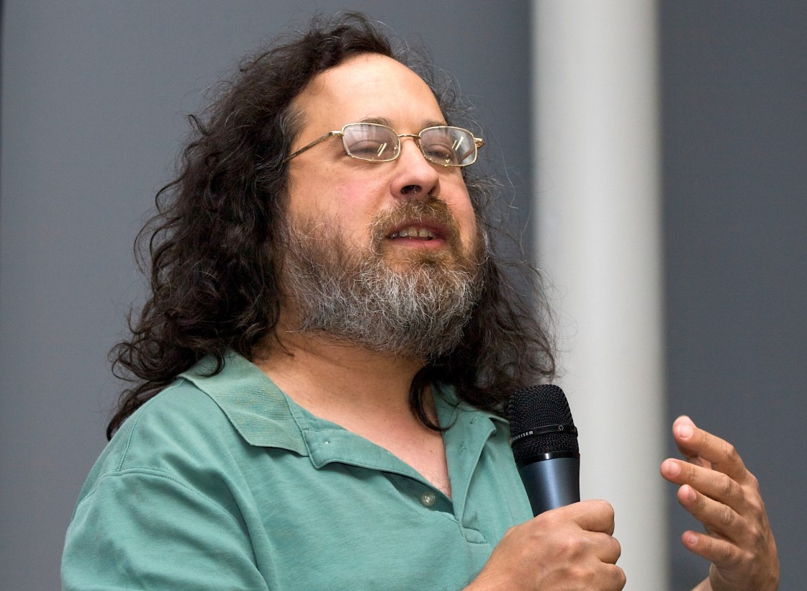
The GNU Project
The GNU Project is a free software, mass collaboration project that Richard Stallman announced on September 27, 1983.
GNU STANDS FOR(GNU’s NOT UNIX)
Established by Richard Stallman, who believes that software should be free from restrictions against copying or modification in order to make better and efficient computer programs.

Slide 5


History of Linux
A famous professor Andrew Tanenbaum developed Minix, a simplified version of UNIX that runs on PC
Minix is for class teaching only. No intention for commercial use
In sept1991, while attending the University of Helsinki , Torvalds became curious about operating systems and frustrated by the licensing of MINIX, which limited it to educational use only. He began to work on his own operating system which eventually became the Linux kernel.

Slide 6

What is Linux? Linux + GNU Utilities = Free Unix
Linux is an OS core written by Linus Torvalds and others AND
a set of small programs written by Richard Stallman and others. They are the GNU utilities.
http://www.gnu.org/
Notes:
Richard Stallman source: http://www.stuffyouwillhate.com/wp-content/uploads/richard-stallman.jpg
Linux Torvalds source: https://netfiles.uiuc.edu/rhasan/linux/Linus_Torvalds.jpg

Slide 7
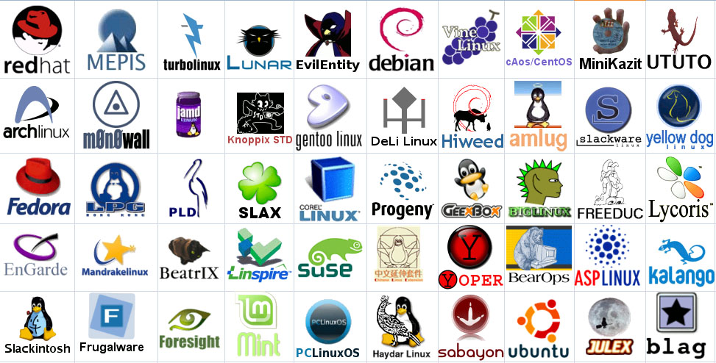
Linux Has Many Distributions
Notes:
Logos source: http://www.muylinux.com/wp-content/uploads/2009/04/logos-distros.jpg

Slide 8
Why Use Linux?
Open Source Nature
What is it like when you buy a car, but you cannot see what’s under the hood? Similar is the case with when you use a Windows-powered system.
However, in contrast, Linux is completely an open source project. You can have a look at the source code of a Linux OS, which is a plus.
Open Source Linux “https://github.com/torvalds/linux”

Slide 9
Why Use Linux?
Secure
Let’s face it; Windows OS is vulnerable to different types of attacks (or hacks). However, Linux is not as vulnerable as Windows. It sure isn’t invulnerable, but it is a lot more secure.
Perfect For Programmers
Linux supports almost all of the major programming languages (Python, C/C++, Java, Perl, Ruby, etc.). Moreover, it offers a vast range of applications useful for programming purposes.

Slide 10
Why Use Linux?
Can revive older computers
As the operating systems evolve, so do their hardware requirements increase exponentially. For instance, if you purchase a genuine copy of Windows 10, you will have to meet the minimum hardware requirements to run it successfully, and you cannot run it on just about any low-end system.
Nevertheless, with Linux, you could even utilize one of your oldest computer systems to achieve a task. However, that does not mean that every Linux distribution would work with 256 MB of RAM coupled with an outdated processor. However, there are options which you can install on such low-end systems as well (such as Puppy Linux).

Slide 11
Why Use Linux?
Software Updates
Microsoft pushes a software update when it receives a set of problems or if something major needs to be fixed. On the other hand, you would observe a software update to address a little problem.
So, with Linux, you will notice more updates to fix the problems you might be facing. You will not only encounter a larger number of software updates, but you will also observe much faster software updates.

Slide 12
Why Use Linux?
Free to Use
Linux is accessible to the public for free! However, that is not the case with Windows!
You will not have to pay 100-250 USD to get your hands on a genuine copy of a Linux distribution (such as Ubuntu, Fedora). So, it is entirely free.

Slide 13
Why Use Linux?
Better Community Support
You do not need to hire an expert to solve a problem you are facing on your Linux system. You just need to search for a similar thread on the web for a solution or post a thread to let others solve the problem. Within minutes of posting a thread on any of the Linux forums, you may expect a reply along with a detailed solution which would finally help resolve your problem at no cost!

Slide 14
Why Use Linux?
Privacy
Microsoft certainly tries to anonymize the data collected from every user. However, it does not look convincing with Microsoft’s latest Windows 10. It has already received an enormous amount of criticism of how it collects data, what it should collect and what it should not.
In contrast, Linux would be the perfect solution for a privacy buff. First of all, Linux distributions do not collect much data (or none). Moreover, you will not be needing additional tools to protect your privacy.

Slide 15
Who uses it
NSA created Security Enhanced Linux (SELinux) to develop better allow the control of dynamic security policies. The architecture they created has been mainstreamed into Linux and ported to other operating systems including Solaris, and Free BSD.
IBM, HP, and Sun contribute heavily to Linux and OSS (Open Source Software)
Even Microsoft’s position on OSS has softened and they are now contributing code to various projects.

Slide 16
Facts about Linux
There are 20,323,379 lines of code in the Linux kernel as of 2018. That might sound like a lot but it’s actually the smallest the kernel has been for some time
Linux is used by every major space programme in the world, including NASA and the ESA. Private space companies like SpaceX also leverage it, with the latter having completed 65 space missions
Linux totally dominates supercomputers. As of 2018 100% of the world’s 500 fastest supercomputers run Linux.
Android is the most successful operating system on the planet — bar none — with over 2 billion active monthly users worldwide, according to Google. And what does Android run on? Why the Linux kernel, of course!
Ubuntu is the the worlds most popular Linux-based desktop operating system. It boasts an estimated 20 million users worldwide. Linux marketshare is estimated at 2-3% of all desktop computer use.

Slide 17

Any Questions?

